Slide 1
Canteen Vendor Management System
Feasibility Analysis

Slide 2
Data Collection & Participants
How We Gathered Information:
Conducted an online survey using Google Forms
Shared through university groups and social media
Collected both structured and open-ended responses
Participants:
Age: 18–30 years
Gender: Mixed (Male & Female)
Occupation: University Students (majority) - Faculty/Seniors (few)

Slide 3
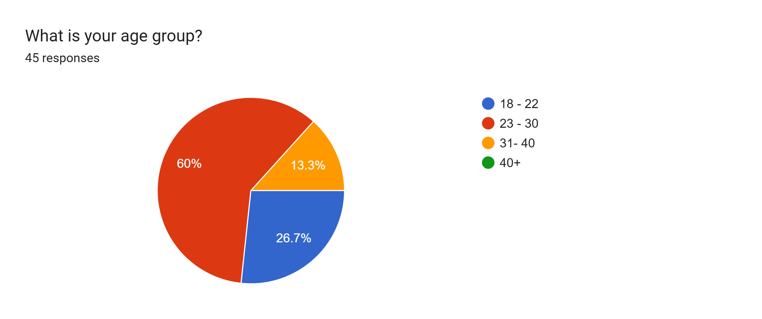

Slide 4
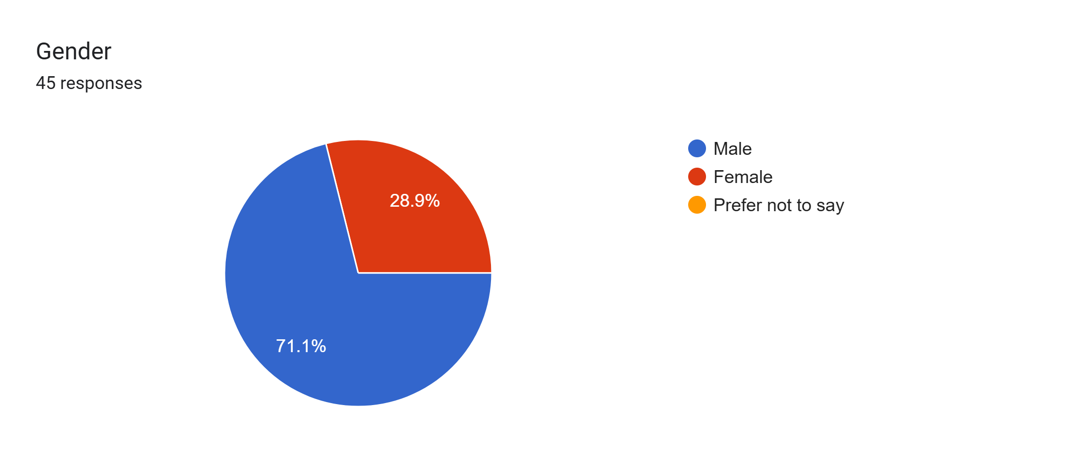

Slide 5
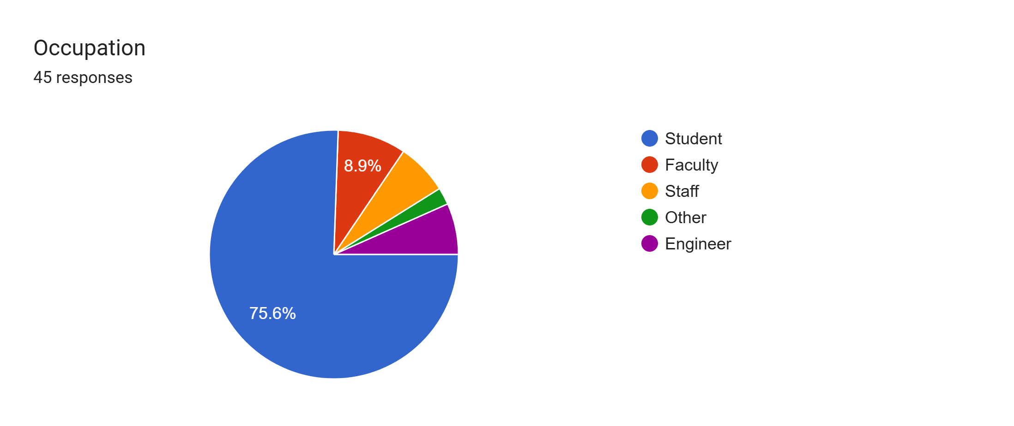

Slide 6
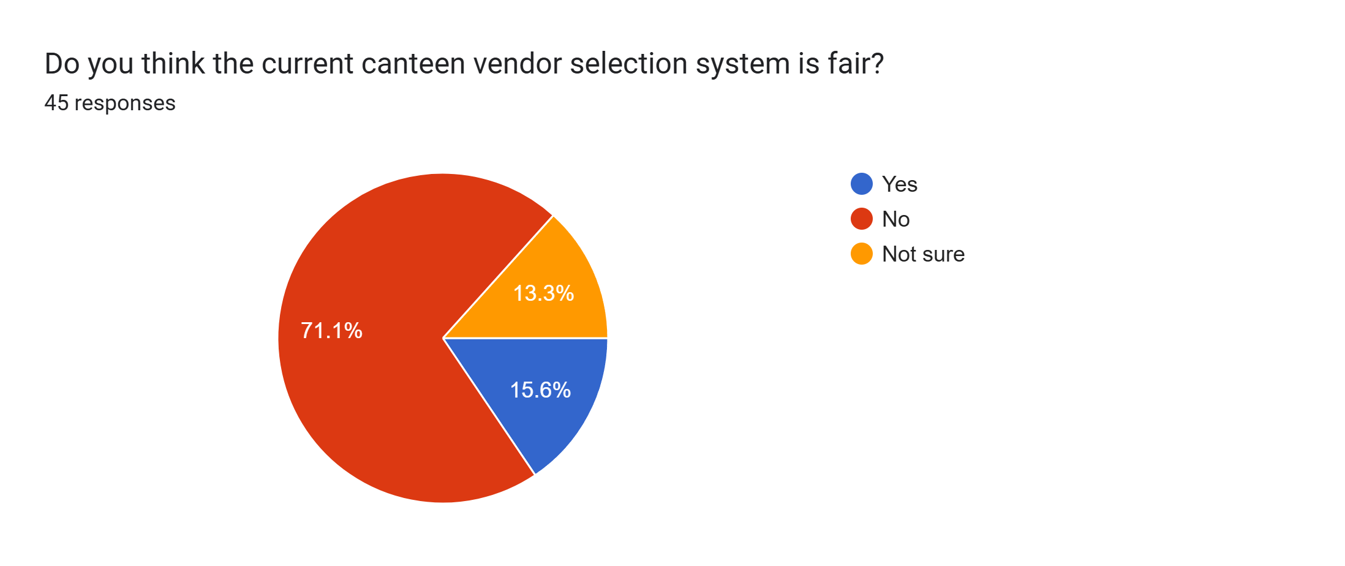

Slide 7
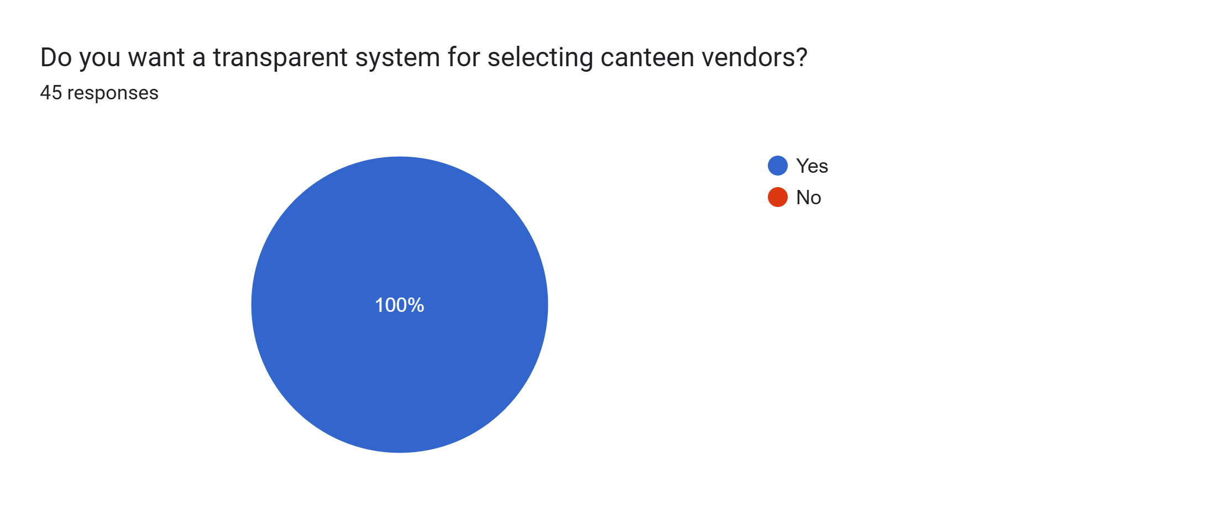

Slide 8
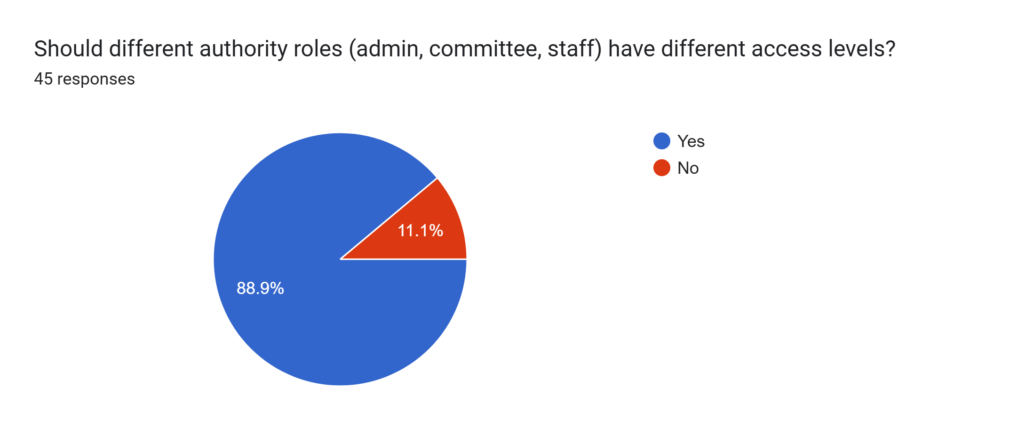

Slide 9


Slide 10
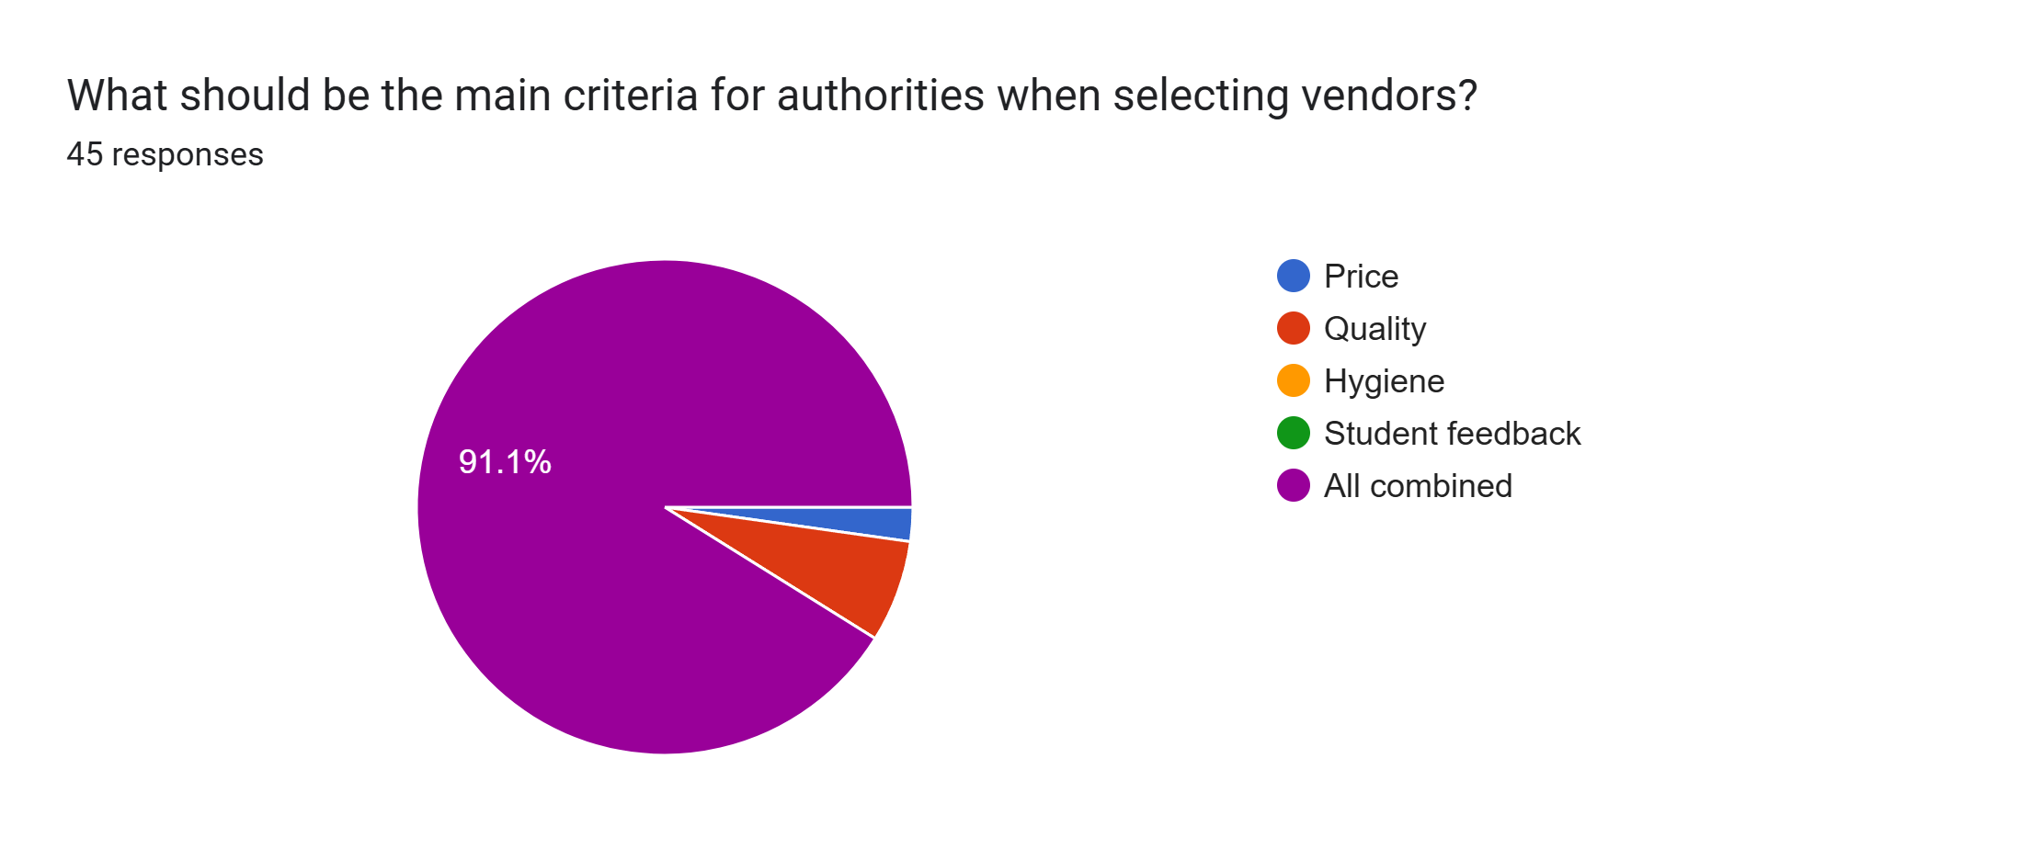

Slide 11
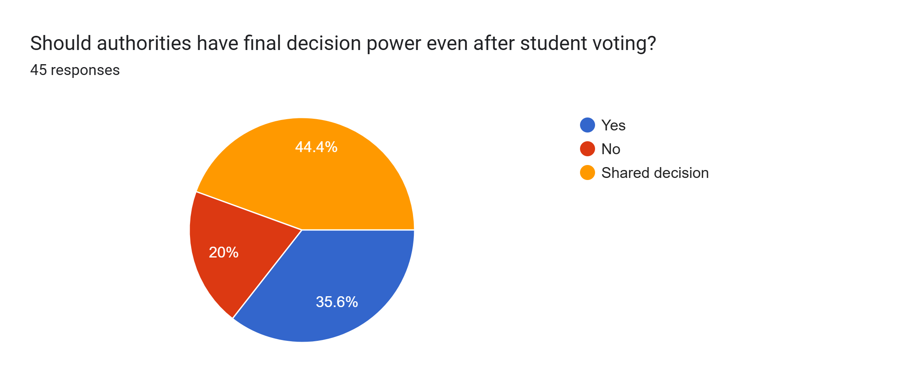

Slide 12
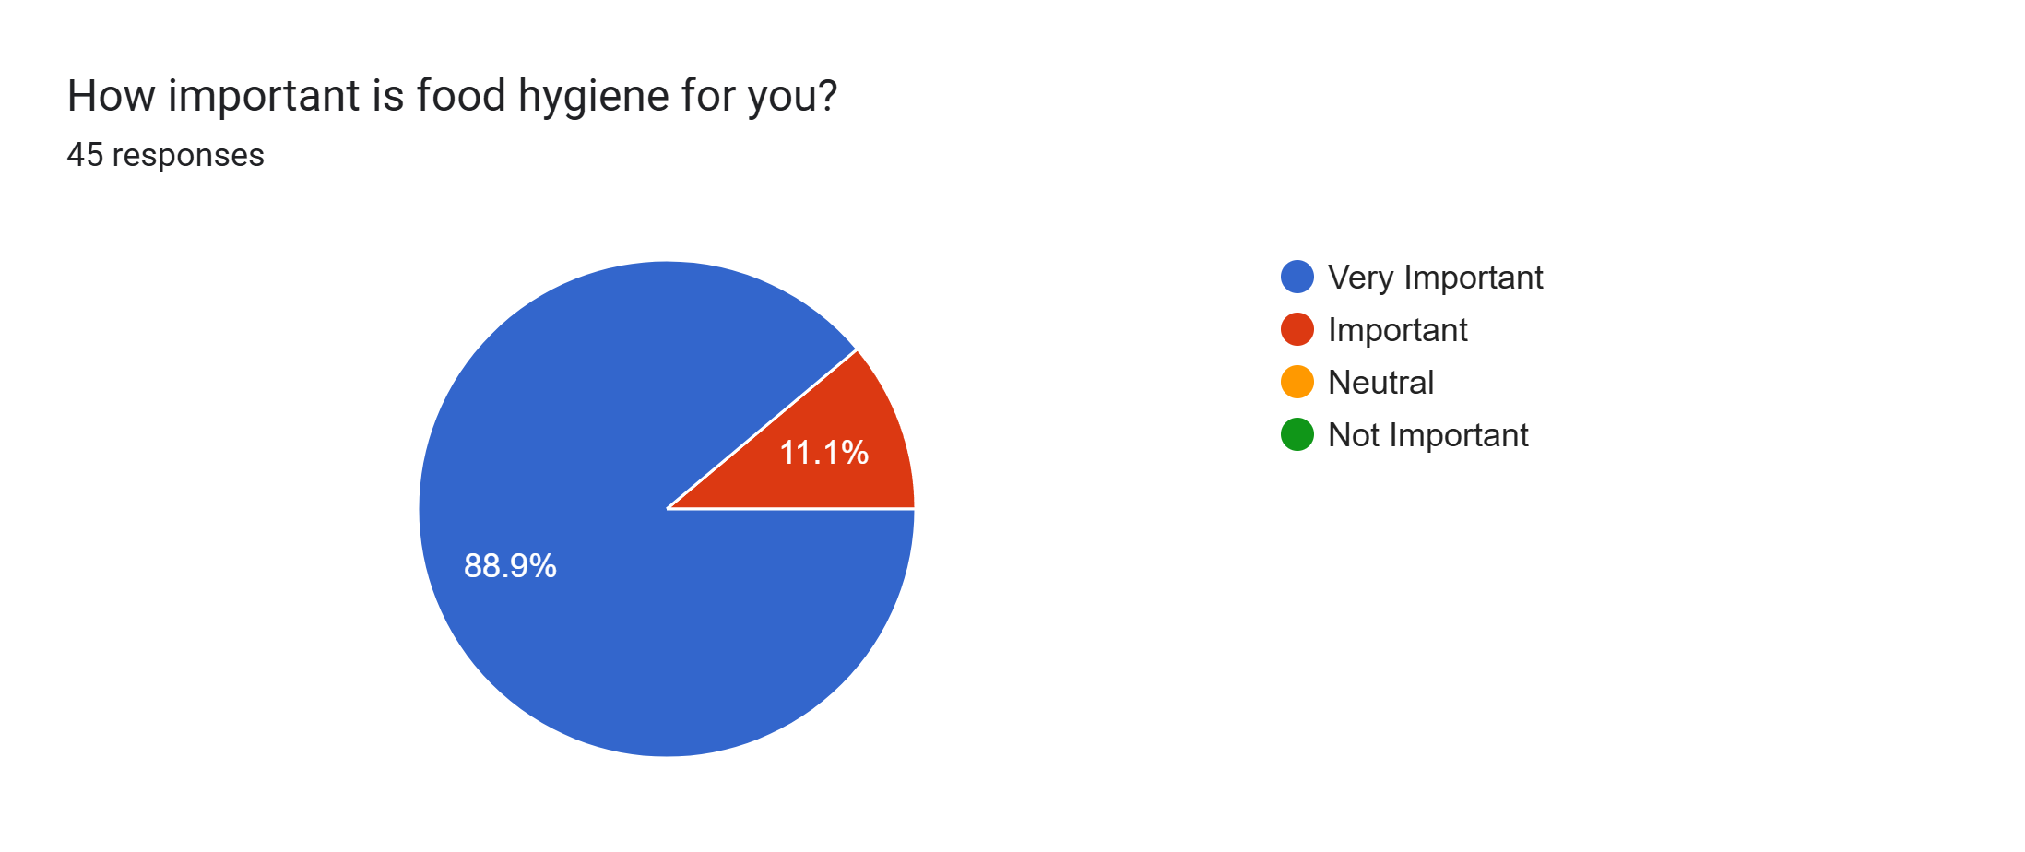

Slide 13
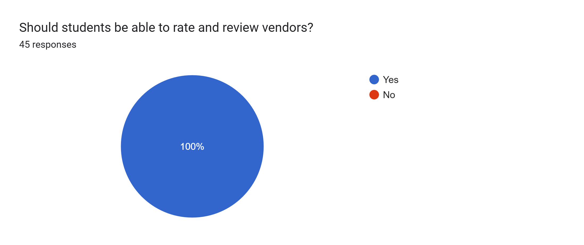

Slide 14
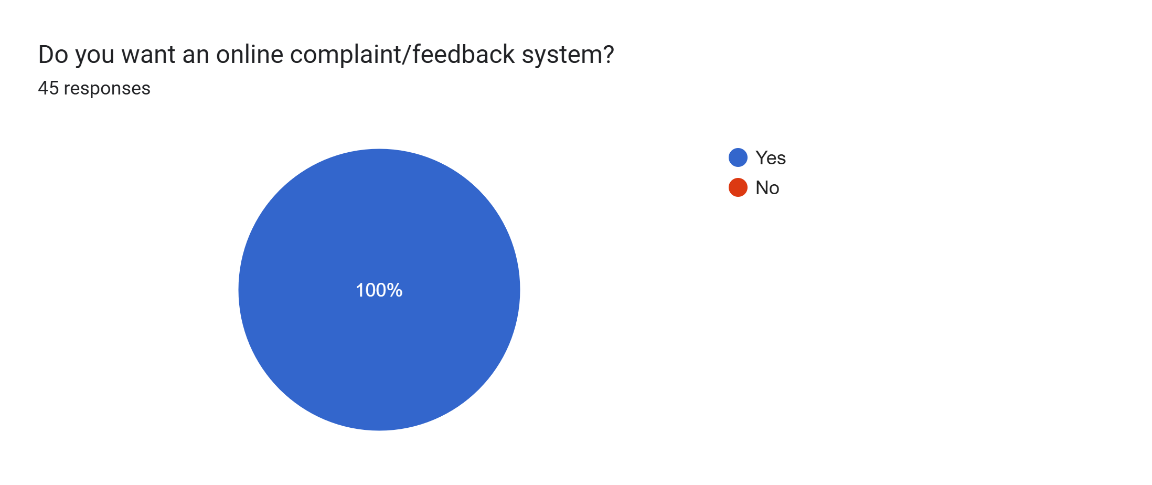

Slide 15
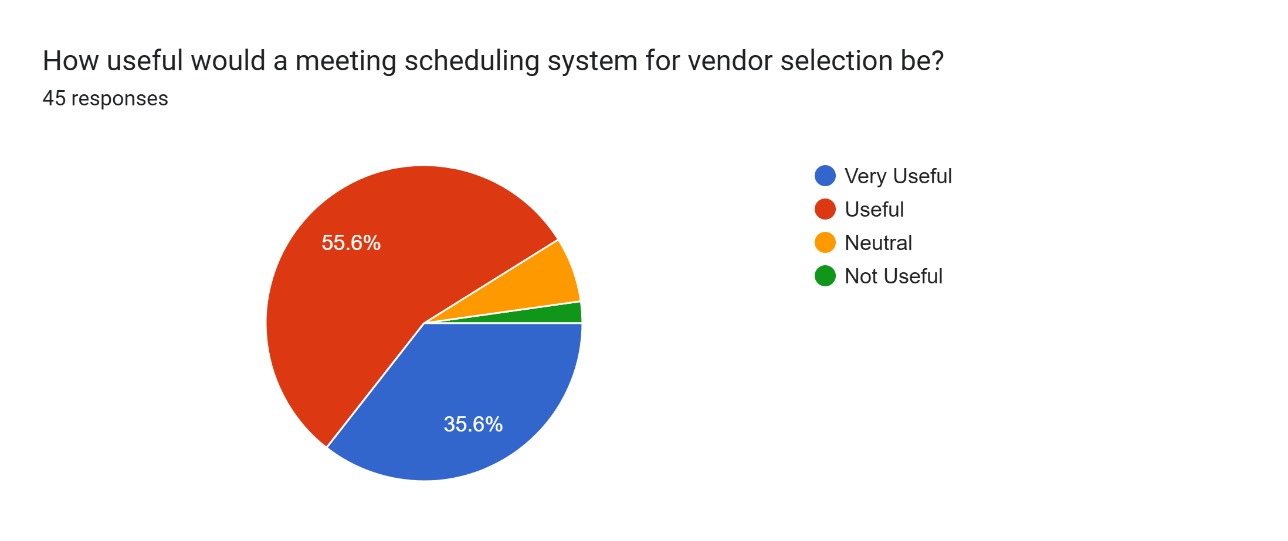

Slide 16
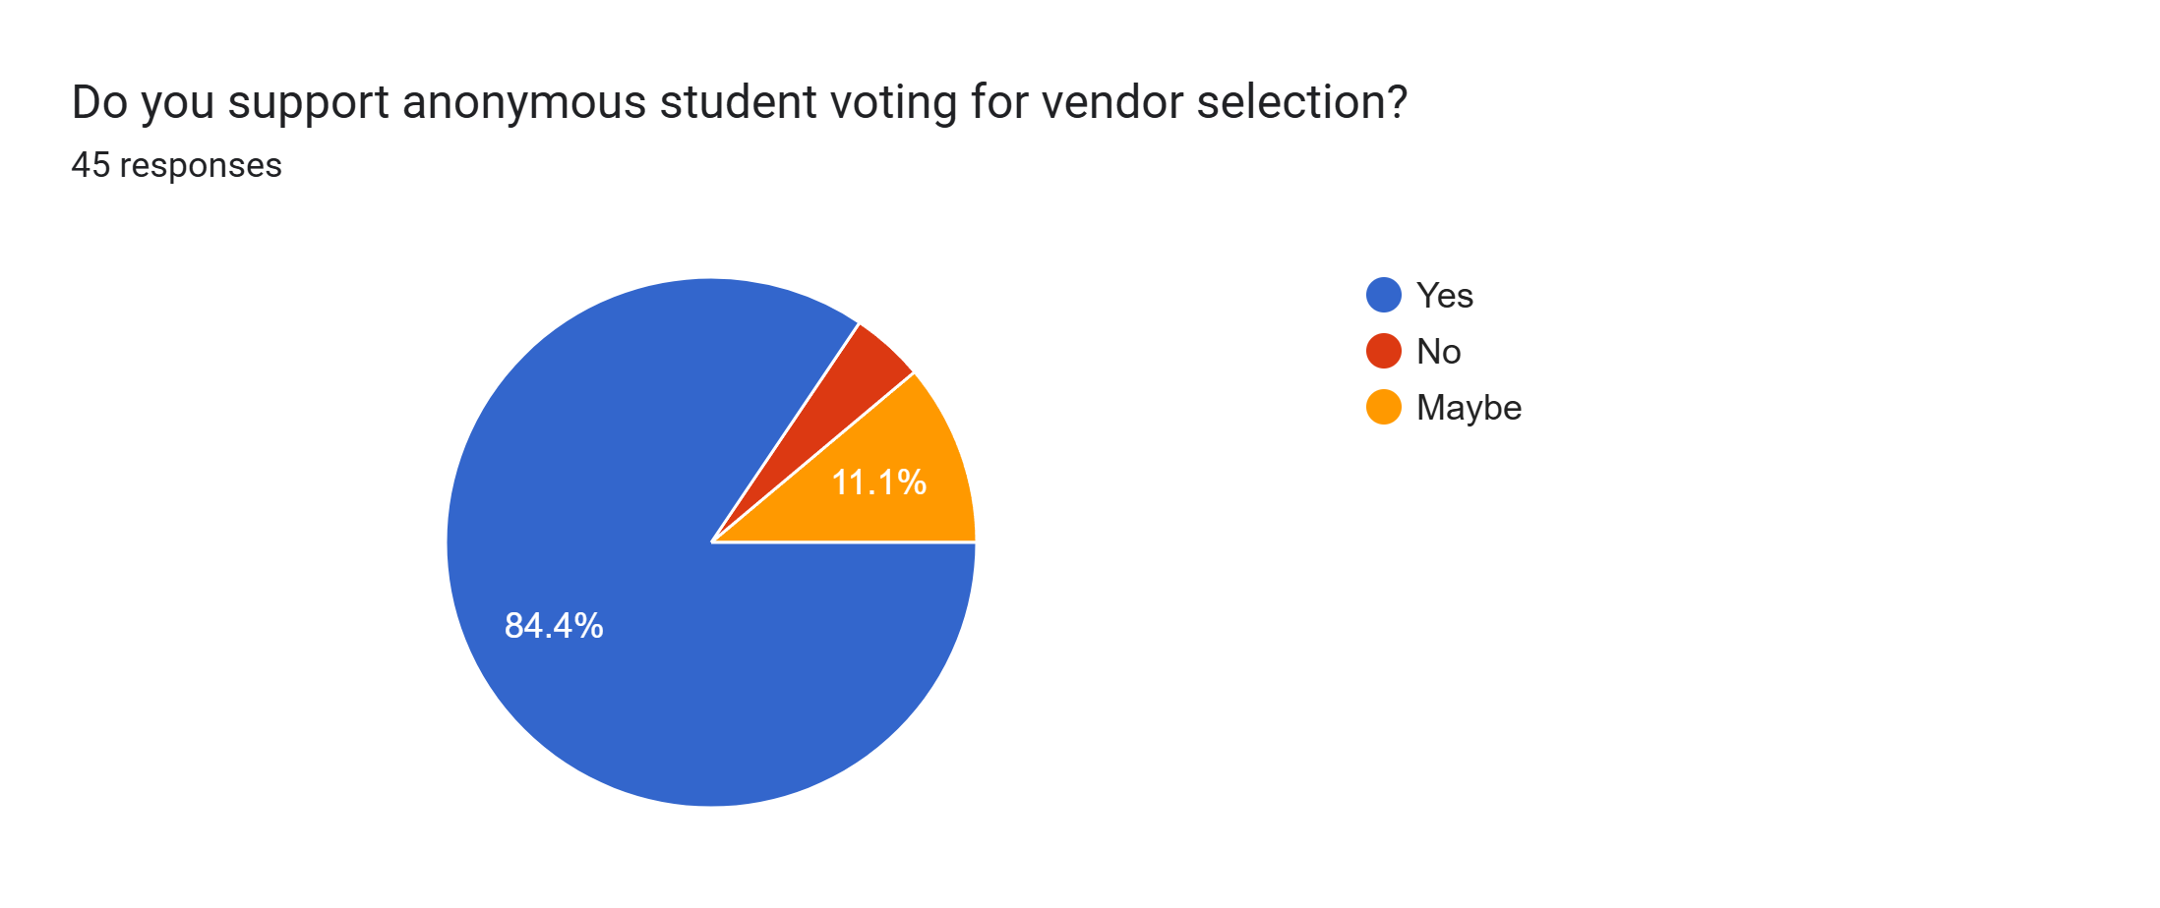

Slide 17


Slide 18
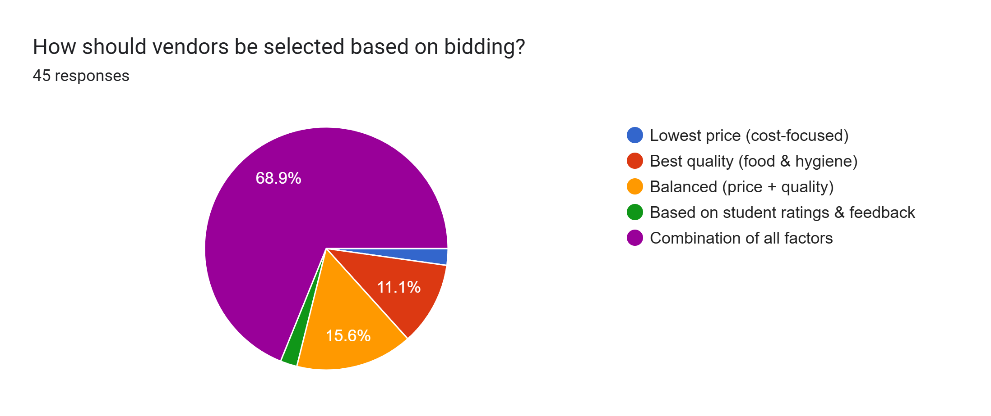

Slide 19
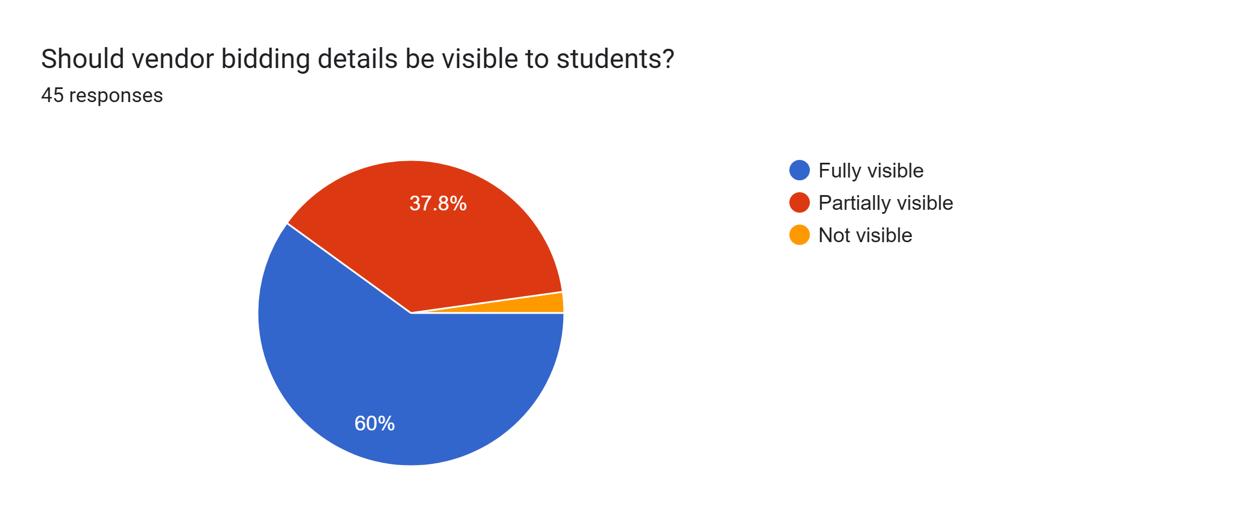

Slide 20
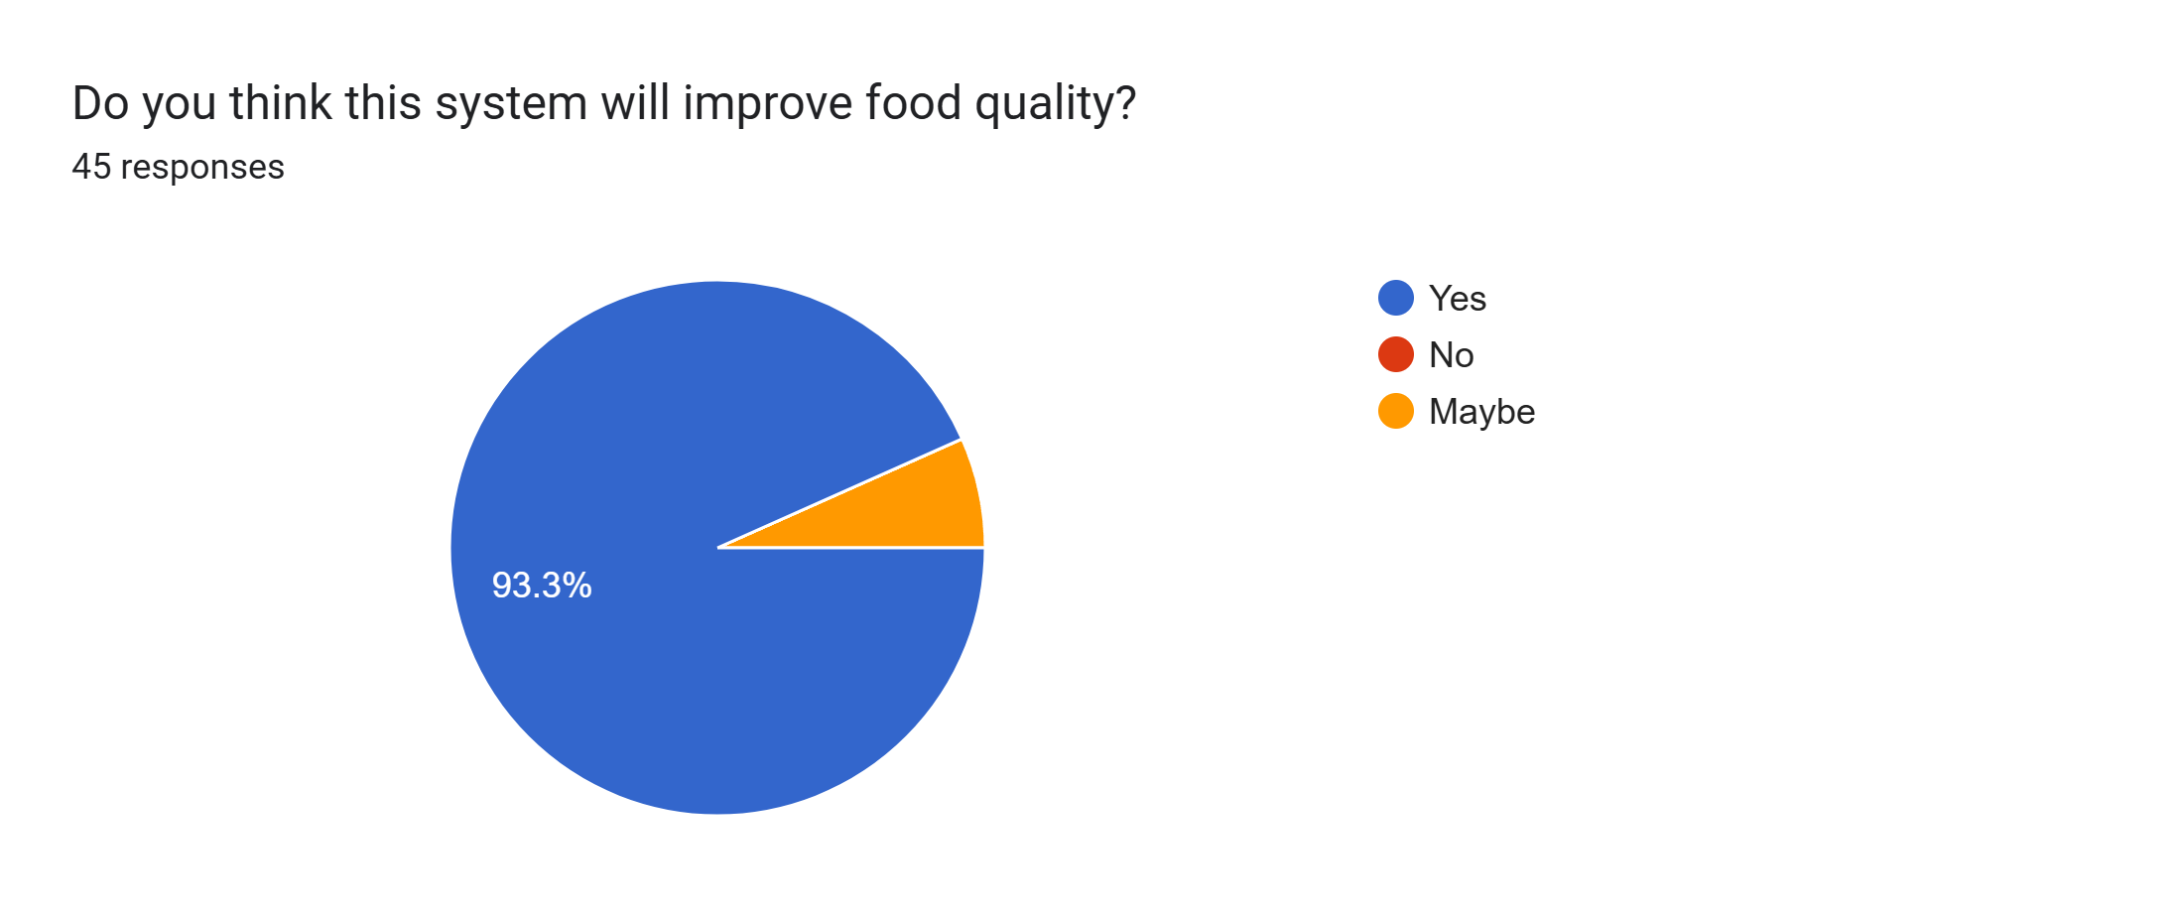

Slide 21
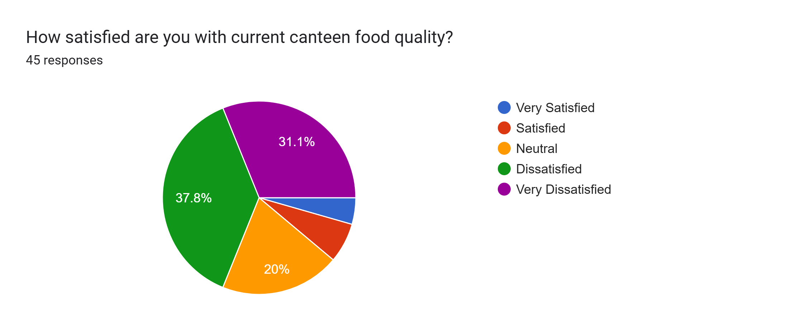

Slide 22
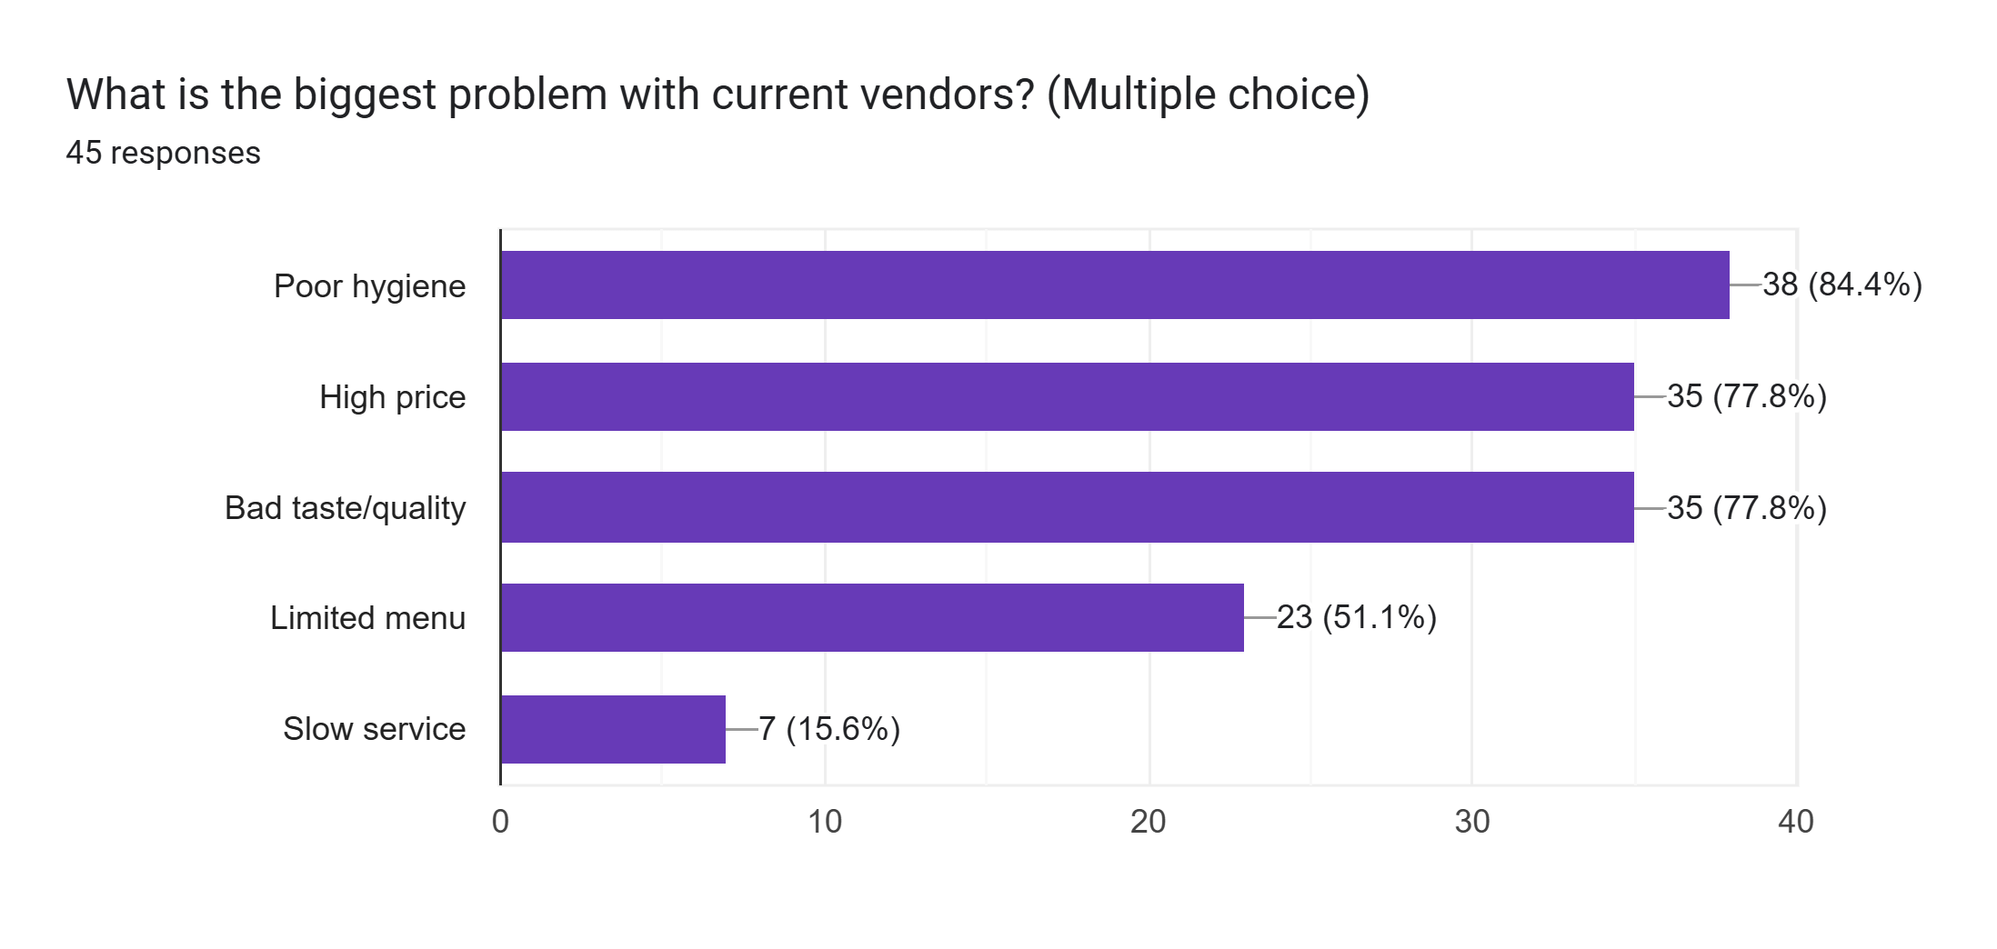

Slide 23
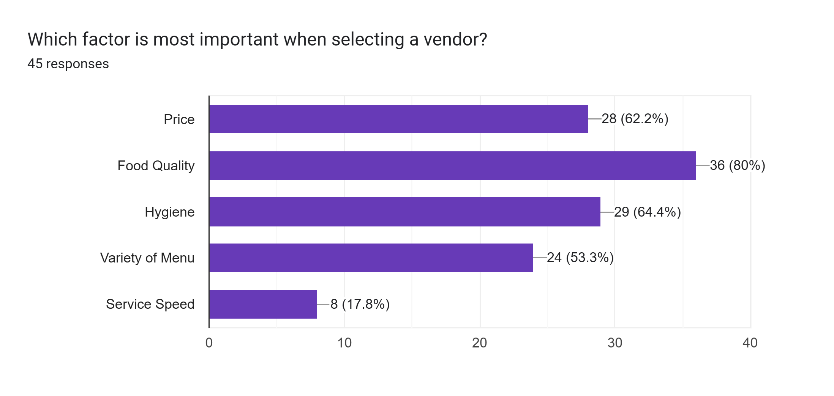

Slide 24
Questionnaire Overview
Key Questions Included:
Do you think vendor selection should be transparent?
How important is food hygiene in canteens?
Should students be able to rate vendors?
Do you support a monitoring system by authorities?
Should vendors be selected through a competitive bidding process based on price, quality, and hygiene standards?

Slide 25
Feasible Features
Vendor Comparison Tools
Vendor Registration & Proposal Submission
Meeting Management System
Student Rating & Review System
Hygiene & Safety Monitoring
Authority Dashboard
Complaint & Feedback System
Performance Analytics

Slide 26
Features to Discard
Food Item(s) Wishlist Integration
Event-based Vendor Selection

Slide 27
SWOT Analysis (Strengths & Weaknesses)
Weaknesses:
Depends on active student participation
Data authenticity (fake reviews possible)
Requires proper authority involvement
Strengths :
Strong positive user feedback
Solves real problem (food safety issue)
Improves transparency in vendor selection
Useful for both students & authority

Slide 28
SWOT Analysis (Opportunities & Threats)
Opportunities:
Can expand to:
Other universities
Corporate cafeterias
Integration with:
Online food ordering
Health inspection systems
Can become a standard campus solution in Bangladesh
Threats:
Resistance from existing vendors
Lack of cooperation from authorities
Competing manual/traditional systems
Data misuse or biased ratings

Slide 29
Thank You

